Slide 1
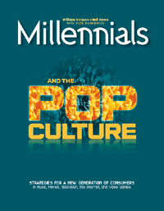


Communicating with Millennials and Plurals
Dr. Pete Markiewicz
Plyojump.com
Lifecourse Associates
http://plyojump.com

Slide 2

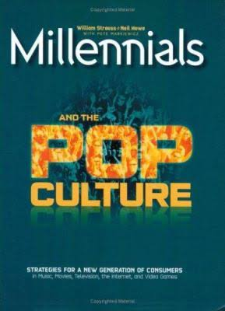
About the Author
“Boomer”
Research Scientist at UCLA & elsewhere in 1970s & 1980s
Jumped to the rising World Wide Web in 1993
Recruited by generational experts Strauss & Howe in 1998
Teaches “Technology and Pop Culture”, Plus Web & Interactive Design, Ux, Coding, Math Literacy at several schools
Talent interviewer, headhunter agencies
(Aquent)

Slide 3
Topics
What are Generations?
How are Generations Different?
Caveats
Generational Trends
  Millennials
  Plurals
Questions and Answers
References

Slide 4




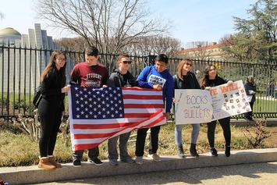
What are Generations?

Slide 5
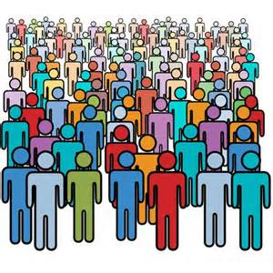
Ways to Split People Up…
Cultural
  Identity
  Economic
Cross-cultural
  Life Stage
  Cohort/Generational
These all help
our understanding

Slide 6
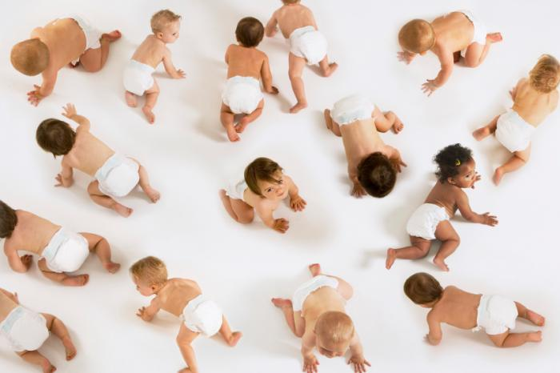
Generations = Cohorts
People born during a particular time in history
  Grow up in a common cultural “zeitgeist”
  Internalize that “zeitgeist” as they age
  Understand change in terms of their original zeitgeist
“Cultural messages” come from
  Parents
  Child-raising theories/manuals
  Media Pop-Culture view of the child

Slide 7
Generations are NOT Lifestage
Lifestage
  Based in biology (universal)
  Attitudes, opinions, set by biological age and culture role for individuals at different ages
Generation/Cohort
  Based in history (don’t happen in static cultures)
  Cohorts experiencing rapid social change as children (Karl Mannheim)
  Attitudes, opinions carry into adulthood

Slide 8
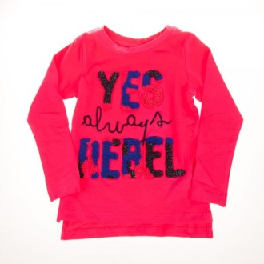
Lifestage vs. Generation
Example of “Life Stage” statements
“…Kids always rebel”
“…old people are conservative”
Example of “Generational” statements
“…Boomers are re-defining what it means to be old”
“...Youth today are closer to their parents in values and culture than the youth of 30 years ago”
Notes:
8

Slide 9

What is Generation-Dependent?
Dependent on cohort/generation
  Taste in music, pop culture
  Sense of personal/collective destiny
Dependent on generation & lifestage
  Politics
  Attitudes to children (the biggest effect is having them)
Dependent on lifestage only
  Candy preference
  Risk-taking behavior
None of the above
  Expectations for children of immigrants

Slide 10
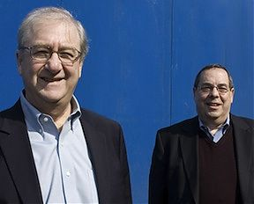

Strauss & Howe, Winograd & Hais
They’re Boomers
“Capitol Steps”
Elaborate (untestable?) theory
Generations created by fertility/mood shifts, parental upbringing styles
Generations last ~20 years
16 defined generations in US history
Generations defined by parental fertility, optimism level
Generational mindmap = mythic archetypes
  Hero, Prophet, Nomad, Adaptive
Sudden pop culture “takeover” occurs when first cohorts of the youngest generation reach their 20s
  GenX/Y ->Millennial transition 2005-2020
  Millennial ->Plural transition 2020-2035
  Plural -> “New Hippie 2035-2050

Slide 11
S&H US Generations
Generation Name | First Births | Final Births
WWII | 1900 | 1922
Silent | 1923 | 1942
Boomer | 1943 | 1960
Xer/GenX | 1961 | 1981
Millennial/GenY | 1982 | 2004
Plural/Homelander | 2005 | ?

Slide 12
Fertility = Economy = Generations
Baby Boom
Baby “Bust” II
Lowest Fertility
ever recorded
Baby “Bust” II
Roaring ‘20s
Postwar Boom
Echo Booms
Great Depression
Baby “Bust III”
Major Recessions
The “Long Boom”
Financial Crisis
(Lost)
WWII
Silents
Boomers
Xers
Millennials
Plurals
https://www.cdc.gov/nchs/fastats/births.htm

Slide 13
Births & Generational Waves
S&L
Crisis
Financial
Crisis
The “Long Boom”
Postwar Boom
Roaring ‘20s
Great
Depression
Major Recessions
WWII
Silents
Boomers
Xers
Millennials
Plurals
https://www.cdc.gov/nchs/fastats/births.htm

Slide 14
Kids Become Important Again
Roe vs. Wade
Xers: “I’m keepin’ my baby”
Xer births
Millennial births
Boomers: “Kids hinder our
self-discovery”
https://www.guttmacher.org/sites/default/files/report_downloads/us-adolescent-pregnancy-trends-2013_tables.pdf

Slide 15
US Population by Age
_{Millennial}
_{Wave}
_{Boomer}
_{Wave}
_{Xer Slump}
_{WWII Gen}
_{Wave}

Slide 16
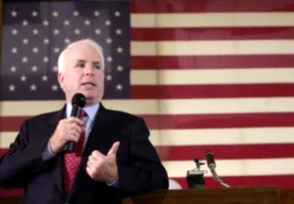



US Generations in 2018
Silents – 76-93
Boomers – 58-75
Millennials are where Boomers were ~1980
Millennials are where Xers were ~1995
Plurals are where Boomers were ~1958
Xers – 37-57
Millennials – 15-36
Plurals – 0-14
Notes:
16

Slide 17
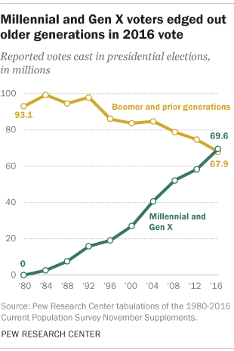
BTW, What about 2020?

Slide 18
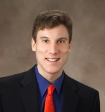
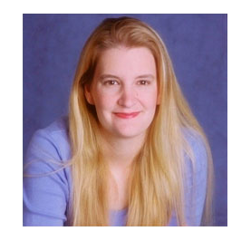
Alternate Generational Models
Marketers (e.g. Bruce Tulgan)
  Mostly technology-based
  Short length (~10 years)
  Ideology to transactional (good for capitalism)
  GenX, GenY, GenZ … oops
Jean Twenge
  Blends Xers and Millennials into “Generation Me”
  Long (~20-30 years)
  Uniformly downbeat (“I’m a loser, baby)
They’re Xers

Slide 19
Generational Names
S & H Name | Marketers | Twenge | Pew
G.I | I don’t care | I don’t care | Matures
Silent | I don’t care | I don’t care | Matures
Boomer | Boomer | Boomer | Boomer
Xer | GenX | Generation Me | Xer
Millennial | GenY + GenZ | Generation Me | Millennials
Plural | Gen Alpha | iGen | Plurals

Slide 20
How are Generations Different?

Slide 21
S&H Generations and Mood
Generations born in a “down” era (economic & fertility) era tend to negative imagery and pop culture
Generations born in an “up” era (economic & fertility) tend to positive imagery, and pop culture

Slide 22
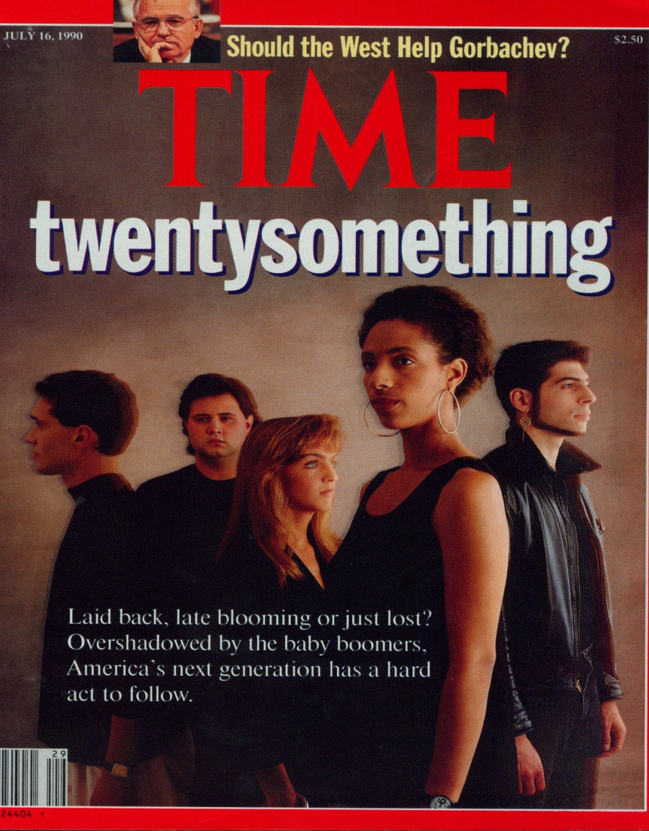
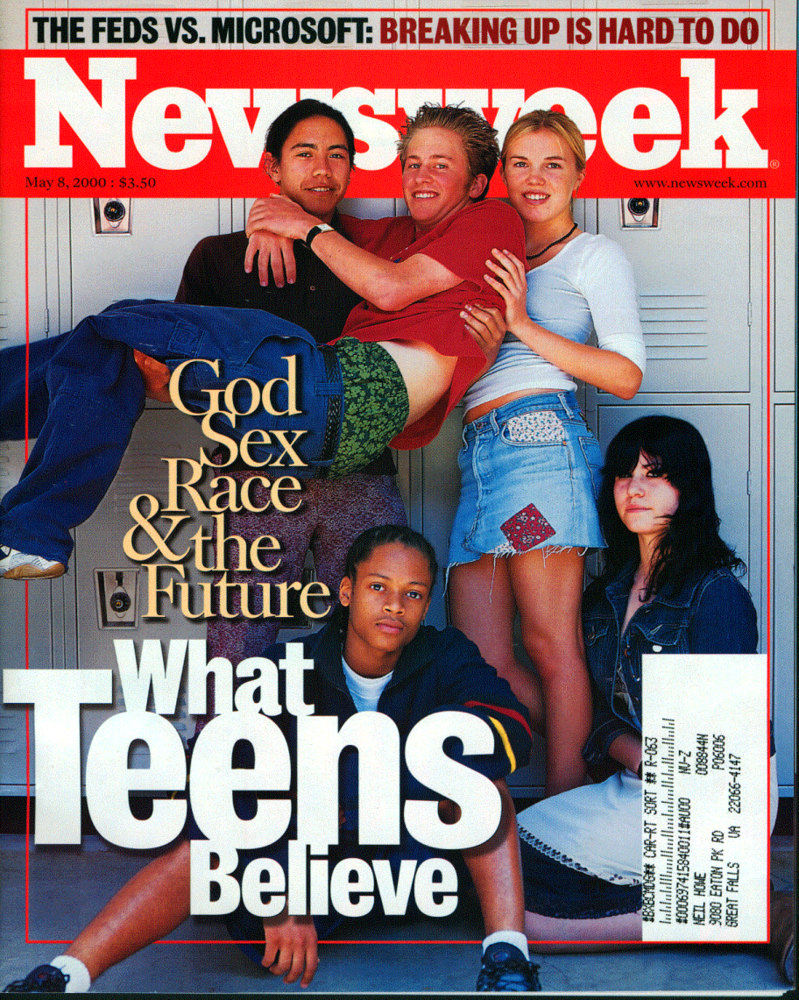
Generational Mood in Print…
GenX (1990)
Millennial (2000)

Slide 23

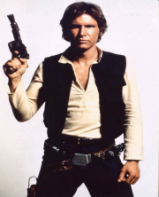

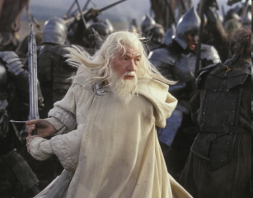
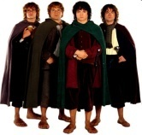
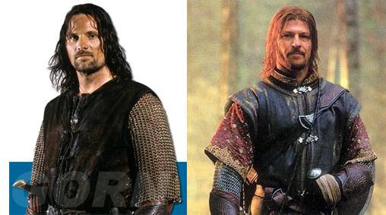
S&H Generational Psychology
Generations see themselves as:
  Heroes fixing the world
  Prophets redeeming the world
  Nomads trying to survive the world
  Adaptives brokering compromise & smoothing progress
Pop culture archetypes = generational styles
Prophet
Boomer
Nomad
Xer
Millennial
Hero
Prophet
Boomer
Nomad
Xer
Millennial
Hero
This is a Different Seminar!

Slide 24
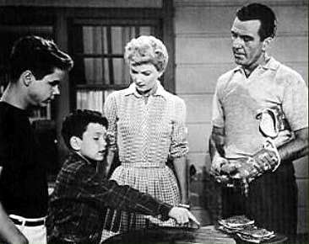
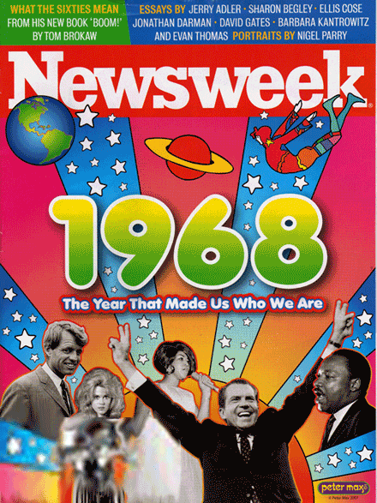
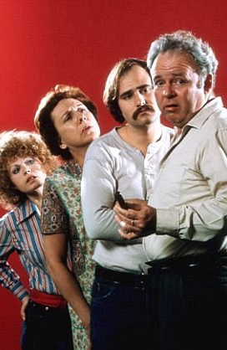
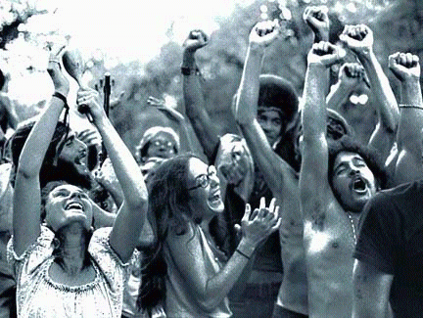

“Boomers” (1943-1960)
PROPHETS
Childhood = UP ERA
  Economic boom
  Indulged as children
  Social stability
  Standards were loosening
Core values
  Upbeat
  Spiritual
  Judgmental
  Perfectionist
  Narcissistic
  Rebellious
Notes:
24
How many baby boomers do we have in this class. Do you agree with the behaviors, in general, that are on this slide as typical not of you so much but of people of your generation?

Slide 25
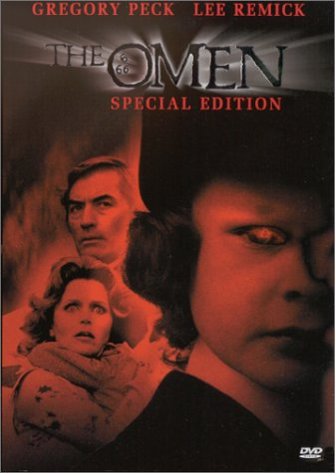
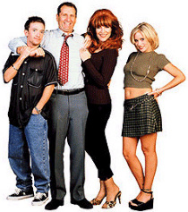
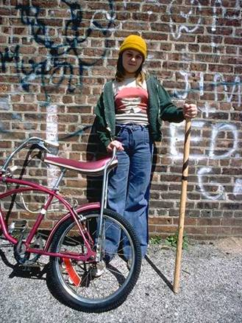
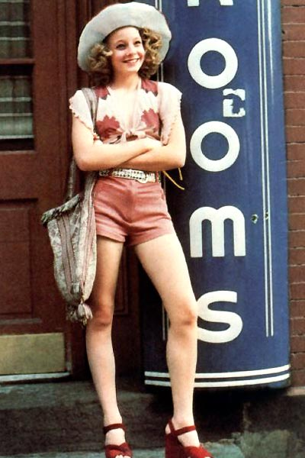
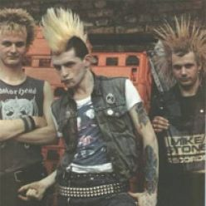
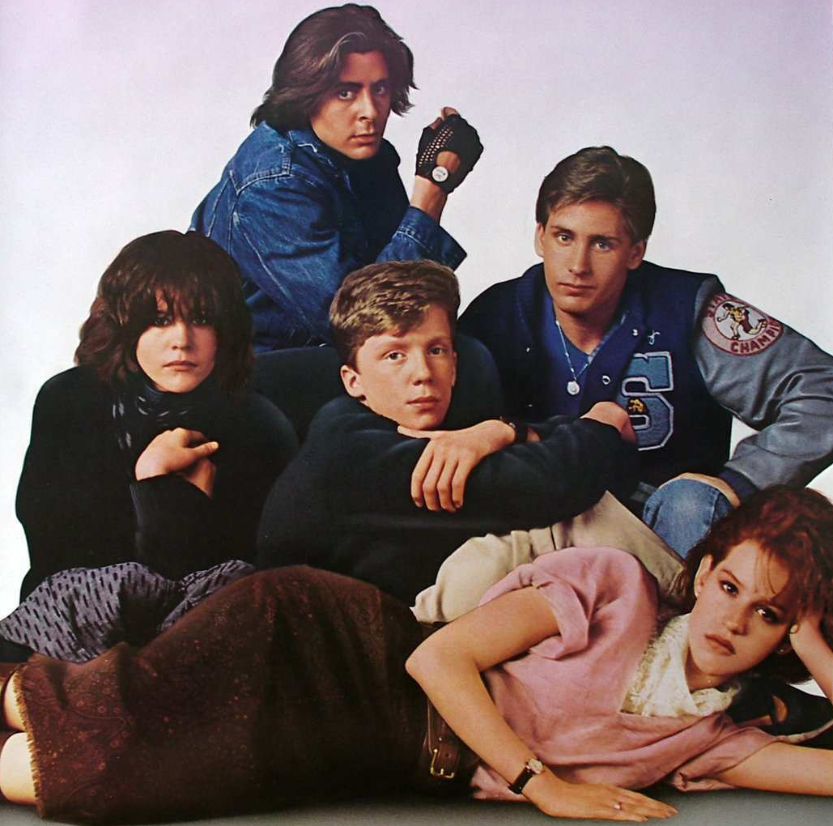
“GenX” (1962-1981)
NOMADS
Childhood = DOWN ERA
  Economic bust
  Children unprotected, criticized
  “Latch-key” childhood
  Social instability
  Standards were loosening
Core values
  Downbeat
  Pragmatism
  Authenticity
  “No Rules” edgy
  “Whatever works”, speed
  Transaction-focused
  Results-focused
Alternate: “New Lost”, “Generation at Risk”
Notes:
25
Generation X is such a mirror image of the Lost generation of the 1920’s that F. Scott Fitzgerald’s Great Gatsby and swing dancing are coming back into style. Both of them are the “Reactive” generational type, basically reacting AGAINST what came before and rejecting almost all of it from politics to child rearing. The Lost generation doted on their kids who became the GI generation. Now Generation X cares more about their kids, the millennials, than any set of parents since. A recent study showed the amount of time parents are now spending with their kids is on the rise and hitting new heights. Just one more statistic of generational change. Gen Xers are determined to right the great wrong done to them in their own childhood, and it is this sense of self-confidence and importance that they are creating in their kids that will make millennials ready to take on the challenges of the future.

Slide 26

GenX/Y childhood in Media
1964 Children of the Damned
1967 Rosemary’s Baby
1971 Willy Wonka
1973 The Exorcist
1974 It’s Alive!
1976 Look What’s Happened to Rosemary’s Baby
1976 The Omen
1976 Bad News Bears
1976 Carrie
Exorcist II: The Heretic
1977 Eraserhead
1978 It Lives Again
1978 Damien—Omen II
1978 Halloween
1979 The Brood
1980 The Children
1981 The Final Conflict
1981 Halloween II
1984 Firestarter
Children of the Corn
1988 Child’s Play
There’s only
one thing
wrong with
the Davis
baby . . .
“Nomad” Archetype

Slide 27
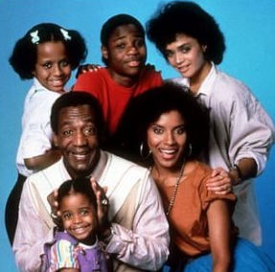

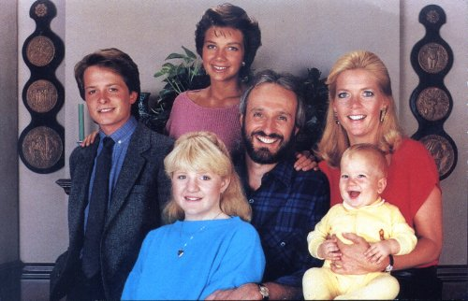

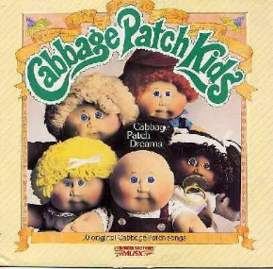
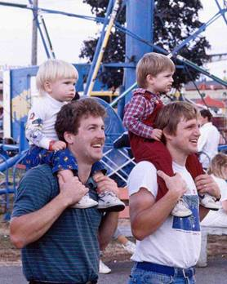
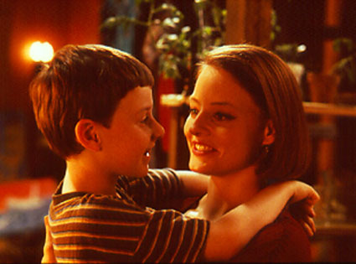
Millennials (1982-2004)
HEROES
Oops!
Childhood = UP ERA
  Economic boom
  Children protected & celebrated
  Helicopter parents
  Ultra-planned childhood
  Social stability via “Lockdown”
  Standards were tightening
Core values
  Upbeat
  Special-feeling
  Confident, optimistic
  Connected, social
  Team-players
  Socially conscious
Alternate: GenY, Nexters, Netsters

Slide 28

Millennial Childhood in Media
E.T The Extra-Terrestrial
1986 Aliens
1987 Three Men and a Baby
1987 Raising Arizona
1987 Baby Boom
1989 The Little Mermaid
1989 Look Who’s Talking
1989 Parenthood
1990 Look Who’s Talking Too
Home Alone
1991 Little Man Tate
Three Men and a Little Lady
1993 Searching for Bobby Fisher
The Lion King
1994 Angels in the Outfield
1997 Liar Liar
1998 Rugrats: The Movie
Big Daddy
1999 The Iron Giant
The Princess Diaries
Spy Kids
2001 Monsters, Inc.
Harry Potter
2002 Big Fat Liar
2002 About a Boy
They changed
her diapers.
She changed
their lives . . .
(Super)hero Archetype

Slide 29
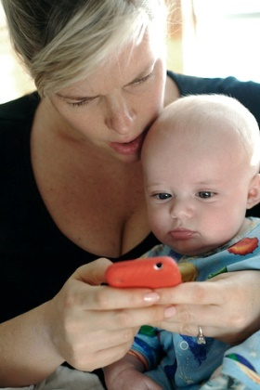

Plurals (2005-?)
ADAPTIVES
?
Childhood = DOWN ERA
  Economic bust
  First generation with > 50% non-Caucasian
  “Soccer mom” replaced by “Slacker Mom”
  Parents protectors, not mentors
  Hyper-polarization of civic space
  Standards tighten to politeness
Core values
  downbeat?
  Virtual = real?
  Polite?
  Lonely in a crowd?
  Grit & slow progress?
?
“Adaptive” Archetype
Alternate: Homeland, Gen Alpha

Slide 30
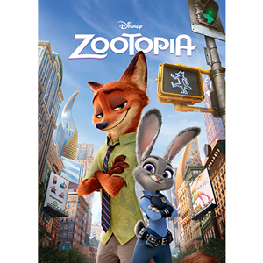
Plural Childhood in Media
2003 Finding Nemo
2004 The Incredibles
2006 Cars
2006 Happy Feet
2008 Wall-E
2008 Kung Fu Panda
2009 Up
2009 Cloudy With a Chance of Meatballs
2010 Diary of a Wimpy Kid
2010 Tangled
2010 How to Train Your Dragon
2010 Despicable Me
2012 Brave
2010 Wreck-It Ralph
2012 Paranorman
2013 Frozen
2014 Minions
2014 Lego Movie
2015 Paddington
2015 Inside Out
2016 Moana
2016 Zootopia
2017 Lego Batman
2017 Coco
2018 Eighth Grade
Welcome to
the (multicultural)
Urban jungle. . .

Slide 31
Caveats

Slide 32

1. You are not Your Generation
Generational features are averaged properties of cohorts
Individuals within a generation may vary widely from the norm

Slide 33
Your personal experience, kids, friends, etc. are NOT a good guide to your generation

Slide 34
It’s NOT About You!

Slide 35

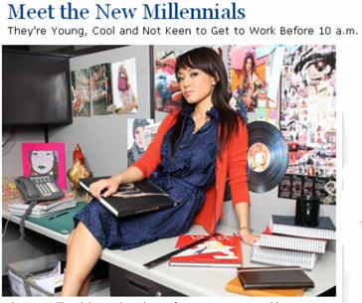
2. No Generation is “Bad”
Negative Millennial comments….
Naïve
Think Mommy/Daddy will fix it
No respect for experience
Think they are evolutionally superior
Belief in personal superiority
Lack basic communication skills
Need constant stroking
Over-complaining
Overly-entitled
Over-sharing
Can’t read a book
Take any comments as criticism
Arrogant Millennial Snowflake!

Slide 36

But There is Truth in Stereotype
Millennials have very high self-esteem
Millennials have difficulty with “long form” media (i.e. a book)
Millennials take comments as criticism

Slide 37
The Same Generational Traits can be seen as positives – or negatives

Slide 38
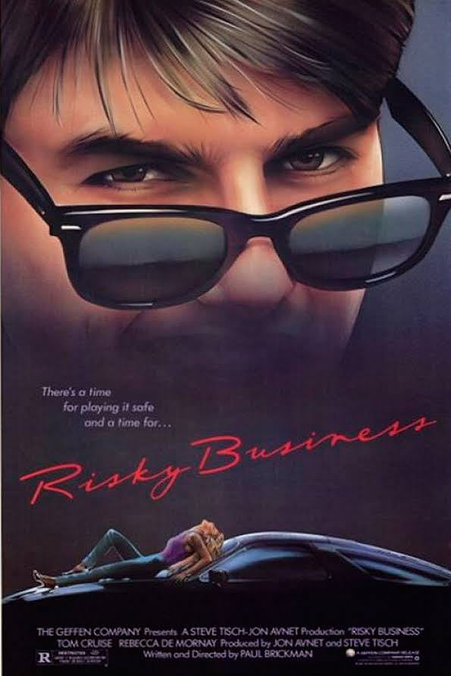
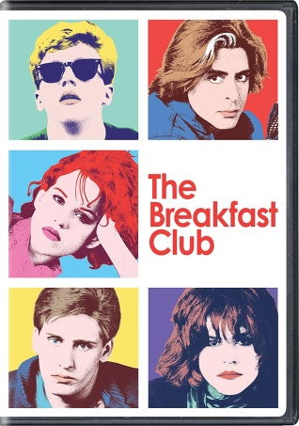
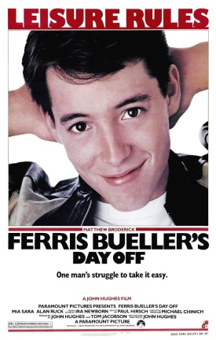
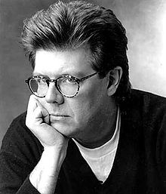

3. Channeling Your Past
Creatives tend to have fewer children & less contact with children
Most miss the rise of a new generation, assuming youth experience = “me squared”
A few figure it out (e.g. John Hughes and Paul Brickman with GenX)
Most do not…
These guys figured out Xers First!

Slide 39
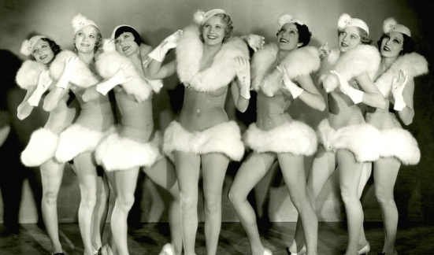
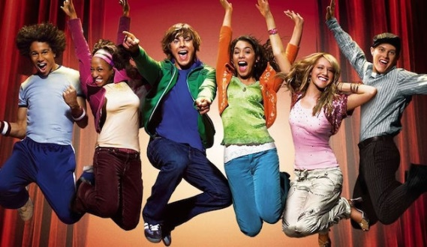
Overheard in 2002
Bill Strauss presents “Millennials and Pop Culture” in Los Angeles seminars, and suggests a bright, busy musical (Busby Berkley) created by a team of optimistic Millennials is the next big thing…
  MTV – Outrageous! We know the kids!
  MTV – Disgusting, and sooooo sexist!
  Paramount – That matches our research, but…
  Disney – We’re jiggy with that!

Slide 40
Millennials and Plurals are NOT here to finish your generation’s agenda!

Slide 41
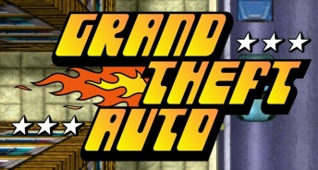
4. Correlation is not Causation
Serious Violent Crime, Age 12-17*
_{GTA 1}
_{GTA 3}
Serious violent crimes are murders, rapes
robberies, and aggravated results
US. Department of Justice ·Bureau of Justice Statistics,
US DOJ Office of Juvenile Justice and Delinquency Prevention
Notes:
41

Slide 42
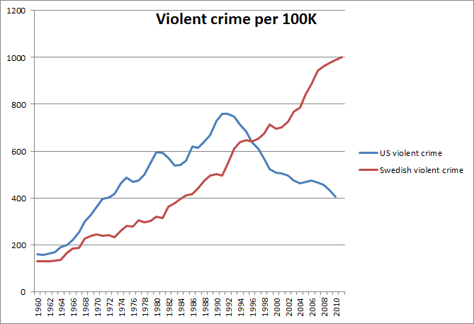
BTW, the USA IS Exceptional

Slide 43

5. You Can’t “Change” Gens
You can’t change cohort behavior, only a few individuals at best
Your “example” polarizes, rather than converts
You can exploit strengths and adjust for weaknesses for each generation

Slide 44
Generational Trends
Millennials
Ages in 2018: 15-36

Slide 45
Millennial Traits Summarized
According to S & H, Millennials are…
  SPECIAL (wizards in training)
  SHELTERED (naïve about real world)
  CONFIDENT (I can do anything))
  CONVENTIONAL (rules, authority have value)
  TEAM-PLAYER (social group most important)
  PRESSURED (work, work, work…)
  ACHIEVING (value society’s rewards)
Superhero, not Anti-hero!

Slide 46
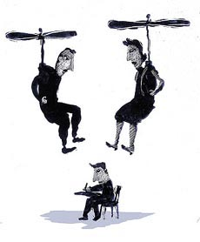
Helicopter Parents
“…Jessica Wolf is being watched. Every homework assignment she turns in, every class she attends, every test the 15-year-old sophomore takes at Sabino High School, her mother, Tina, can simply log on to her home computer and check her daughter's academic progress….via the Tucson Unified School District's parental-access system, an online network that allows parents to track attendance and grades and e-mail teachers.
At some other local schools, parents can even check what their kids buy for lunch…”
Daniel Scarpinato, Arizona Daily Star, http://www.azstarnet.com, 10.16.2005

Slide 47
Millennial Sexual Activity
Any Sexual Activity 15-19
Wow, gender parity!
https://www.cdc.gov/nchs/data/nhsr/nhsr104.pdf

Slide 48
Teen Moms by Generation
Teen Pregnancy, Birth and Abortion rates per 1000, Ages 15-19
Boomers
Xers
Millennials
Roe vs. Wade
Teen birthrate
lowest in 70 years
Abortion rate
Lower than 1972
https://www.guttmacher.org/sites/default/files/report_downloads/us-adolescent-pregnancy-trends-2013_tables.pdf

Slide 49
Out of Wedlock – Relative
Out of Wedlock Births, Normalized, 1980-2008
Older generations show a rise in births. They are the same cohorts that had high teen births in the 1990s
Xers
Millennials
Younger Generations show a drop in births
http://childstats.gov

Slide 50
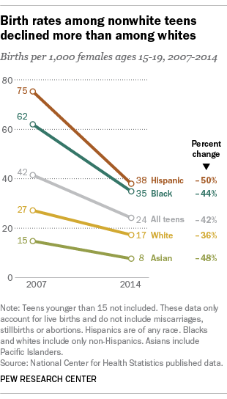
Since You Ask…

Slide 51
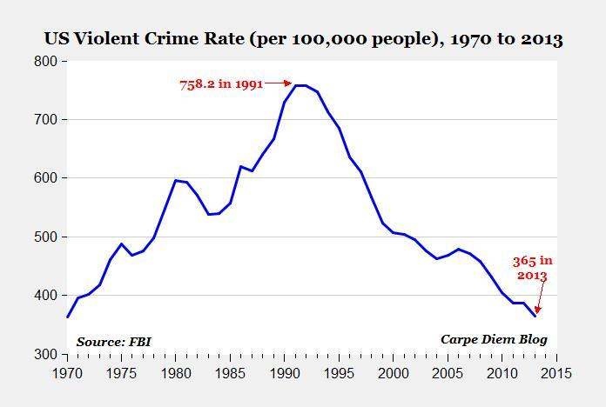
BTW, US Crime is Generally Falling

Slide 52
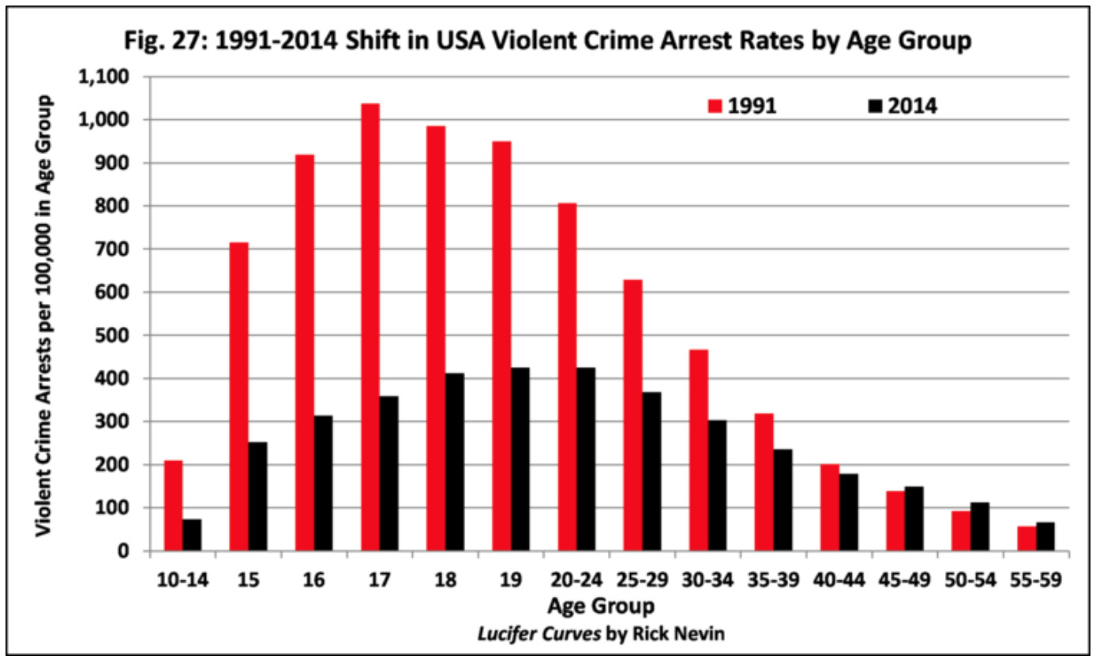
Millennial Crime Falls Faster
Young people had a massive drop in crime
Old people had a rise in crime

Slide 53
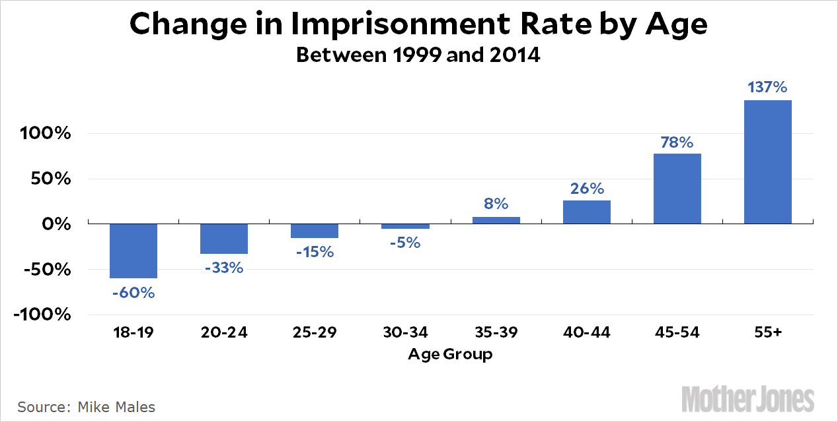
Fewer Millennials in Jail
Millennials are better-behaved
than you were!

Slide 54
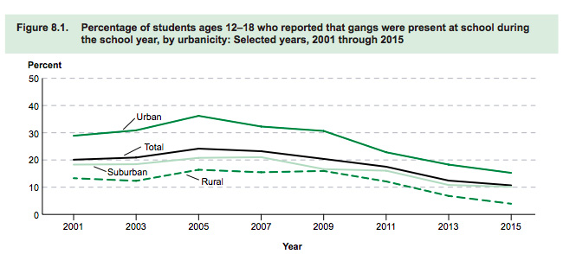
Fewer Gangs
Why do movies act like it’s getting worse?

Slide 55
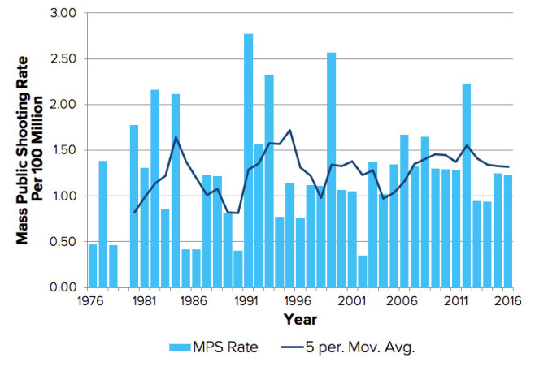
School Shootings (all)
Not more frequent Than 2000s
https://www.politico.com/magazine/story/2017/10/04/mass-shootings-more-deadly-frequent-research-215678

Slide 56

School Shootings II (mass)

Slide 57

BTW, Gun Ownership is Falling
Why were school shootings
nonexistent here?

Slide 58
Drug Use by Generations
Boomers
Xers
Millennials

Slide 59

More on Drug Use
Boomers were the stonedest!

Slide 60
Outer vs. Inner Values
“Be Well-Off Financially”
% Agreeing
“Meaningful Philosophy of Life”
https://www.heri.ucla.edu/monographs/50YearTrendsMonograph2016.pdf

Slide 61

Delayed Adults?
Less than ½ of Millennials have ever held a job before reaching college
Millennials are just beginning to buy their first cars
More Millennials depend on
their parents before and
after graduation for support

Slide 62
Teen Labor Force Participation
Xers
25-54
Boomers
Millennials
Participation %
16-24
55+
Teens continue to leave the workforce from 1970s peak
https://www.bls.gov/emp/tables/civilian-labor-force-participation-rate.htm

Slide 63

Want a Job?
Xer: You want fries with that?
Millennial: job after college?
Plural: when am I assigned a job?

Slide 64

Car Ownership
Small Millennial uptick
http://www.latimes.com/business/autos/la-fi-hy-millennials-cars-20161223-story.html

Slide 65

Social Norm vs/ “Inner Compass”
Older generations have a feeling (excitement, sadness), and call a friend to share…
Millennials call a friend to get their next feeling…
Millennials consult the group to know
what to think/feel next! – Sherri Turkle, MIT

Slide 66

New Social Norms

Slide 67

Everything is Negotiable
“…Older people use their mobile phones to "micro-co-ordinate" with partners during
the day in order to run their errands more efficiently and … younger people, who have never known paper diaries or an unconnected world, micro-co-ordinate in order to avoid committing themselves to any fixed meeting time, location or person at all. After all, a better opportunity might yet present itself…
-The Economist,” Homo Mobilis, April 10, 2008

Slide 68

The Shallows
“The Shallows” (Nicholas Carr)
  Millennial reality is transactional, rather than conceptual
  Network technology replaces focused thought with ADD-like management of fast data streams
Millennials are…
    Good at sorting, organizing, collaborating
    Poor at meaning, deep thought, long focus on a single task
SOURCE: “The Shallows” by Nicolas Carr, 2010, Norton

Slide 69
Civic Engagement
Voting Rates, Presidential Elections
Xers Begin Voting
Millennials Begin Voting
https://www.census.gov/newsroom/blogs/random-samplings/2017/05/voting_in_america.html

Slide 70
Millennial Trends - Volunteerism
Youth volunteer activity, 1976-2004

Slide 71

“No Religious Affiliation”
However, most Millennials label themselves “spiritual”
and atheism remains rare

Slide 72

Millennial House of Worship

Slide 73
Generation Sloth

Slide 74
Negative Health Trends
A growing number of Millennials have documented disabilities
Millennials take drugs to get “better” (Boomers took drugs to get worse)
Lack of physical activity = obesity
Millennials could be the first US generation with a lower life expectancy than its parents

Slide 75
Girls Rule…

Slide 76

Boys Drool (for a while)…
Men become most likely
to drop out of school
SILENTS
BOOMERS
XERS
G.I.
LOST
Women tend to leave
college before graduating

Slide 77
Growing Gender Gap in College
College “gender gap” by age, 1st wave Millennials
 | Low-income (Less than $30,000) |  |  | Middle-income ($30,000 to $69,999) |  |  | Upper Income ($70,000 or more)
 | 1995-96 | 1999-00 | 2003-04 | 1995-96 | 1999-00 | 2003-04 | 1995-96 | 1999-00 | 2003-04
White | 46 | 42 | 42 | 50 | 46 | 43 | 52 | 48 | 49
Black | 32 | 36 | 36 | 48 | 42 | 42 | 41 | 48 | 48
Hispanic | 43 | 43 | 39 | 46 | 51 | 42 | 50 | 52 | 49
Asian | 53 | 51 | 47 | 57 | 48 | 50 | 52 | 54 | 51
All | 44 | 42 | 40 | 50 | 47 | 44 | 51 | 48 | 49
Data: U.S. Department of Education, National Center for Education Statistics, National Postsecondary Student Aid Studies, 1995-96, 1999-2000, 2003-04
Income ranges adjusted for inflation to 1995-96 dollars; Source: ACE Center for Policy Analysis
http://www.usatoday.com/news/education/2005-10-19-male-college-cover_x.htm

Slide 78

Generation Debt

Slide 79
Millennial Take-Home
Better social behavior
Adulthood delayed (but ultimately will happen)
Specialness (from entitled to snowflake)
Conventional NOT “edgy”
Inclusive, increasingly diverse
Social norming (edge pulled to center)
Less sex, drugs, rock and roll
Pragmatic, not conceptual
Team/social consensus, versus a “third eye” or “inner voice”

Slide 80
Generational Trends
Plurals
Ages in 2018: 0-14

Slide 81
Most Millennial Trends Continue…
More diverse population
Better social behavior
Social norming for all identity groups
Delayed adulthood
Sense of entitlement

Slide 82

Demographics is Destiny
Much higher diversity than Europe or Asia!

Slide 83
A Few Trends Look New
“Grit” or dogged achievement of goals via small steps
Tolerance becomes manners
Physical isolation
Virtual substitutes for the real
Less confident, happy

Slide 84
S&H Plural Archetype
“Today, Boomers invest much of their energy in settling old scores with their ideological opponents rather than solving problems.”
“Plurals would prefer to take small steps toward their goal, as they did in Florida, rather than bask in the purity of their cause.”
http://www.newgeography.com/content/005941-boomers-meet-plurals

Slide 85

The Plural Future
“Plurals are destined to play a role like the one the Silent Generation played after World War II - smoothing out society’s disruptions and divisions with slow progress and a willingness to compromise.”
http://www.newgeography.com/content/005941-boomers-meet-plurals

Slide 86




Plural Grit in Action
S&H match
Plurals with
1950s Silents
Parkland Protesters are respectful, and determined
vs.
NOT
1960s Boomers!

Slide 87

The “Lonely Crowd”
She’s right once in a while!
Plurals are less independent, nonconformist than any generation in US history
With Plurals, virtual communication replaces, rather than augments the physical world.
Plurals spend less time in the real world, more in the world of social ideas.
Virtualization may contribute to a
worsening social mood.
https://www.theatlantic.com/magazine/archive/2017/09/has-the-smartphone-destroyed-a-generation/534198/

Slide 88
Sex Going Away…
12th-graders in 2015 were going out less often than eighth-graders did as recently as 2009.
56 percent of high-school seniors in 2015 went out on dates; for Boomers and Gen Xers, the number was about 85 percent.
The number of sexually active teens sexually active by ninth grade has dropped by almost 40 percent since 1991.

Slide 89
Nearly all Boomer high-school students had their driver’s license by the spring of their senior year
More than one in four teens today lack one at the end of high school.

Slide 90

Social Becomes Virtualized

Slide 91

Replace the Real with Virtual

Slide 92

BTW, Fave Networks
They don’t use these…

Slide 93

Devices Over Partying

Slide 94

Virtual = Suicidal?

Slide 95


Plurals = Lonely Crowd 2

Slide 96


Lonely & Depressed

Slide 97

Teen Suicide Going Up Again…
Plurals
Millennials

Slide 98


Plurals = “Lonely Crowd”
BTW, Silents had the most sex!

Slide 99
Plural Take-Home
Better becomes “Polite” public behavior
Grit wearing a grey flannel suit
Surveilled & Surveilling
Public shaming & silencing culture wars discussion
Rising physical isolation, less sex, independence
Virtualization of reality
“The Lonely Crowd”

Slide 100

https://www.theatlantic.com/magazine/archive/2017/09/has-the-smartphone-destroyed-a-generation/534198/

Slide 101




“The Lonely Crowd” : 2039
“Trouble With Harry”
“Vertigo”
“Pleasantville”
“A.I.”
S&H Generational Archetype Prediction
For Midlife Plurals

Slide 102
Questions & Answers

Slide 103
Questions 1 - Sensitivity
Student complains about the insensitivity of an Instructor’s teaching, leaving the instructor baffled.
  Student feels they received a bad grade because of race, gender, etc.
  Student believes that the “other side” of a political argument cannot be mentioned.
  Students sensitive to ‘gendered’ language

Slide 104
Sensitivity Comments
Millennials genuinely believe in a mass social, political, economic AND creative leveling of society
They are attracted to the center, and want include “the edge” (not celebrate oddballs)
Rules-based thinking implies that there IS a wrong (in art as well as politics)
Some issues have been “solved” and should never be raised again - “We are the first to think rightly”
Boomerish and Xer parenting styles empower Millennials to feel their ideas must be considered equal to Instructor

Slide 105


Slide 106
Questions 2 - Snowflakey Reactions
Student complains about insensitivity of Instructor’s teaching
  Students reactive negatively to “life or death” speech
  Students react negatively to “scared straight” speech
  Students feel they don’t know what to do

Slide 107
Snowflakey Comments
Millennials have lower real-life experience than any generation in US history
Many in college have no experience with having a job, driving a car
Those with no experience map instructor, boss to the role of a protective, sheltering parent
“Scared straight” arguments (effective with GenX) feel like an attack on family values to Millennials

Slide 108

Snowflakey solutions
Hold your nose and praise them
  Constant praise for small success
  Institute a point reward system, even literal “gold stars”
  I said LITERALLY gold stars
  Buy their work by small rewards
Research instead of Pontification
  Instead of stating, have them research online articles that say the same thing
Demonstrate and encourage respect
  Demonstrate that older and wiser is just that

Slide 109

Snowflake solutions
“Parental” mentoring style
  Advise rather than preach
  REPEATEDLY set ground rules (esp. cheating)
  Constantly “ping” the student to ascertain their status
Packet-Switched Connection
  Accept nonlinear interaction (virtual office hours)
Create structure
  Specific assignments with detailed structure
  Timelines, timetables, deadlines
  Have exact rationale for grades, assignments ready
  Metric for success (score-keeping)

Slide 110
Questions 3 – Bliss vs. Punching In
Students complain about course requirements and teaching style
  Students’ hostile to “open-ended” assignments.
  Students feel the only kind of “A” possible is an “A” for effort.
  Students feel they should be able to re-negotiate a grade at any time

Slide 111
Bliss vs. Punching in Comments
Millennials believe in a rule-based society, rather than and focus on standards instead of creative leaps
“No rules” is far scarier to Millennials than Xers or Boomers
Creativity is a common identity trait, any identity-driven creativity is already “perfect” and deserves an “A”
Limited real-life experiences have not supplied a “reality check”

Slide 112

Bliss vs Punching In Solutions
Tell them exactly how to succeed
  Detailed rules for completion of class (syllabus)
  Assignments with defined success (think game levels)
  Reference base rules (e.g. syllabi, final projects, textbooks) constantly in-class
Negotiate
  Negotiation is not insubordination
  Negotiate based on your (paternal) rules
Break their work into tiny, progressive steps
  Unbundle complex tasks
  Reassemble into small, progressive, tasks
React to “insanely great” ideas
  Have them critique their own ideas, rather than doing it (Socratic method)

Slide 113






Recommended Reading
_{Not Everyone Geta A Trophy:}
_{How to Manage Generation Y}
_{by Bruce Tulgan (2009, Wiley)}
_{ISBN: 978-0-470-25626-8}
Millennial Makeover: MySpace, YouTube & The Future of American Politics by Morley Winograd, (2008, Rutgers) ISBN: 0-8135-4301-0
_{Millennials Incorporated}
by Lisa Orrell (2008, Wyatt-MacKenzie) ISBN: 978-1-932279-82-5
Millennials and the Pop Culture by Pete Markiewicz, (2005, Lifecourse)
http://lifecourse.com/store/books.html
Generations: A History of America’s
Future 1594 to 2069 by William Strauss
& Neil Howe (1992, Harper)
ISBN: 0688119123
Millennials Rising: The Next Great Generation
(2000, Vintage), ISBN: 037570719-0

Slide 114
Several Hundred
Additional Slides
Upon Request
…Thanks for listening!

Slide 115
Appendix 1: Generational Mood
 | Boomer | Xer | Millennial | Plural
Archetype | Prophet | Nomad | Hero | Adaptive
Technology | Reject, create | Explore | Embrace | Cocooned, stifled
Reality | Natural | Authentic | Connected | Virtualized

